Slide 1
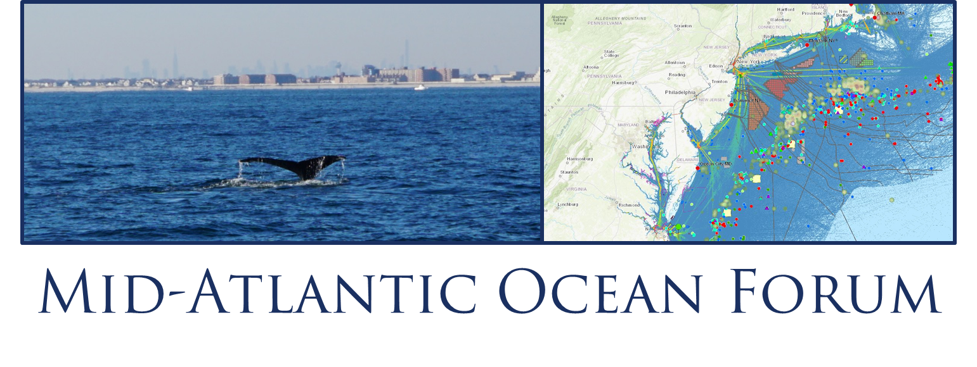


Regional Coordination on Sand
& Sediment Resources
Notes:
Presenter
2016-07-05 12:28:17
--------------------------------------------
First speaker introduces role to RPB process and notes role of second speaker

Slide 2
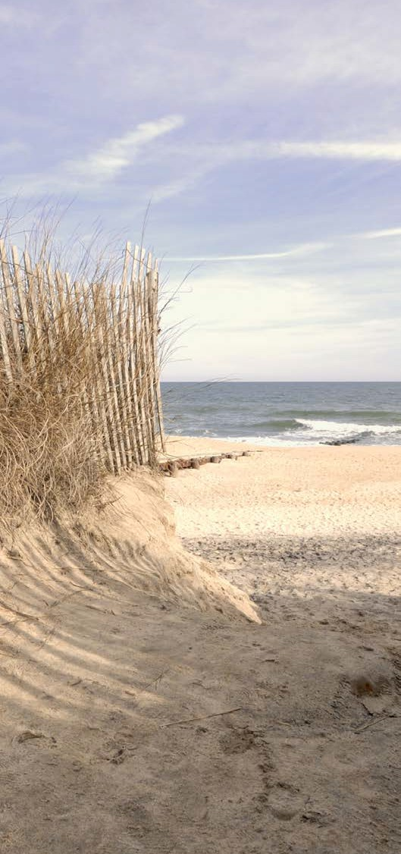
Panelists
Tom Herrington, Moderator
  Associate Director, Urban Coast
  Institute
Jeff Waldner, P.G., Physical Scientist/Oceanographer, BOEM
Donald E. Cresitello, Senior Coastal Planner, US Army Corps of Engineers
Chris Constantino, Environmental Specialist 3/Project Manager, NJDEP- Division of Coastal Engineering
Notes:
Presenter
2016-07-05 12:28:19
--------------------------------------------
Enhancing capacity for entities to bemore effective Reiterate does not change existing authorities

Slide 3
BOEM - Marine Minerals Program
Stewardship Role
  Responsible for managing Outer Continental Shelf (OCS) non-energy marine mineral resources, particularly sand and gravel used to foster coastal resilience.
  Promote integrated adaptive resource management principles and develop practicable mitigations to avoid and/or minimize impacts.
Program objectives
  Sand Resource Evaluation
    National Sand Inventory
    Marine Minerals Information System
  Resource Management and Optimization
    Address Infrastructure and Stakeholder Use Conflicts
    Environmental Studies and Operational Research
  Collaboration, Partnership and Communication

Slide 4
USACE
Sediment Deficits Across North Atlantic Division
  New York District (NY and NJ)
  Sand Need – 94.5 MCY
  Sand deficit of 42.5 MCY for three projects: Sandy Hook to Barnegat Inlet, Section 1 and 2 (22.5 MCY), Long Beach, NY (20 MCY) and FIMP (23 MCY)
      Greater than anticipated use of existing borrow area following Hurricane Sandy
      High gravel content making dredging difficult
      Source no longer suitable based upon environmental considerations and local sponsor input on sand suitability
  Offshore vs. Nearshore/navigation channel: Primarily offshore, with limited navigation channel opportunities like Long Beach, Rockaway and FIMP
  Philadelphia District (NJ and DE)
  Sand Need – 161.5 MCY
  Sand deficit for eleven projects (9 NJ, 2 DE) – 48 MCY
  Greater than anticipated use of existing borrow area following Nor’Ida, Hurricane Sandy and 2015/2016 Fall and Winter Storms
  Current borrow areas must be reviewed closer to verify sand deficit estimate.
  Offshore vs. Nearshore/navigation channel: Primarily offshore, with exception of Roosevelt Inlet in DE; ~4 projects utilize non-Federal navigation channels
  Baltimore District (MD)
  Sand Need – 7.2 MCY
  Offshore Borrow vs. Nearshore/navigation channel: Offshore with limited inlet shoals
  Norfolk District (VA)
  Sand Need – 33.3 MCY
  Sand deficit of 18 MCY for one project: Virginia Beach
    Greater than anticipated use of existing borrow area following various coastal storms
    Increase use of defined borrow source by other agencies and organizations
  Offshore Borrow vs. Nearshore/navigation channel: Primarily offshore with select areas in Atlantic Ocean Channel
  Sediment Need for the next 20 years – 134,000,000 CY from predominantly offshore borrow sources

Slide 5
NJDEP – Division of Coastal Engineering
NJDEP – DCE’s Role
  Administer NJ’s storm damage reduction projects
  Manage/Fund storm damage reduction & resiliency studies
  Liaison to stakeholders – Municipalities/Counties/State & Federal Agencies
  Identify Sand Resources
Challenges
  Sediment Budget and RSM
    Limited quantity and quality – within currently authorized borrow areas
    New Sources – Further away
    Sediment Budget Management within Project
      Does the project need to be re-evaluated
      Additional coordination with Resource agencies
      Do current easements allow it
      Sand is ‘Privately’ owned
  Fish and Wildlife impacts
    Habitat impacts – Fisheries and BNB
      Temporary vs Permanent (what to do to offset or minimize impacts)
    Recreational concerns
  Competing interests
    Windmills – transmission cables and footprint of farms
    Commercial Fisheries

Slide 6

Opportunities
Information sharing on best practices
Need for acknowledgement, discussion, and coordination on competing uses
Sharing insight on challenges such as permitting and time of year restrictions

Slide 7
Stakeholder Input & Discussion
Other issues we should coordinate on or consider related to sand and sediment resources?
Notes:
Presenter
2016-07-05 12:28:19
--------------------------------------------
Enhancing capacity for entities to bemore effective Reiterate does not change existing authorities

